Slide 1

THE WORSHIPFUL COMPANY OF TAX ADVISERS
Presentation to the joint EDI Committee of the ATT & CIOT
Lorraine Parkin
19th May 2026

Slide 2
Agenda
Aligned Objectives & Policies to address EDI
Supporting tax training together
ATT, CTA, ADIT, DITT, Returners 2 Work Initiative
Supporting tax education together
The Livery Schools Link (LSL) ( The London Careers’ Fair)
Swanlea School Careers’ Fair
Further complementary activities by WCTA & its charities
Local Village Network & the Livery Companies
City St. George’s Future Professional Summer School
Q&As

Slide 3
Aligned Objectives & Policies
CIOT
- Primary purpose to promote education in taxation
TABF
- Supports general tax education under its policies and professional tax education for those suffering hardship
ATT
- Primary objective to promote education & the study of tax administration & practice
TACT
- Supports education under its policies
Complementary objectives & policies in education
Great collaboration

Slide 4
Supporting Tax Training Together
Professional Qualifications
The Tax Advisers’ Benevolent Fund is for the relief of hardship for past and present members of the ATT and the CIOT and their dependents. Under its policies this includes supporting the cost of tax education for those who cannot afford it.
TABF’s provisional figures for Tax Education Grants and Bursaries awarded in FYE 30 June 2026 are as follows:
ATT -- £8,031
CTA - £6,315
ADIT Bursaries- £9,909
DITT Bursaries - £1,972

Slide 5

Supporting Tax Training Together Cont.
Returners 2 Work Initiative
We’re proud to have given a 3 year commitment to the CIOT’s Returners to Work Initiative
£5,000 p.a. 2025 to 2027 inclusive
We understand from your own EDI feedback that initially awareness and take up was low but we are pleased to learn that following your Webinar in March awareness has increased and more applications for the program have been received.

Slide 6
The Livery Schools Link (LSL)
The LSL aims to promote support for schools in the Greater London area by Livery Companies & their members, helping to prepare young people for the world of work
The LSL acts as a link between schools in need of help and members of the Livery who wish to offer assistance in any form
The LSL’s mission is to assist children from less advantaged backgrounds to receive an enhanced educational experience at school & to have their personal aspirations raised, thereby increasing their employability and career options
WCTA is an active member of the LSL

Slide 7
The Livery Schools Link (LSL) Cont.
The London Careers Fair takes place annually at the Guildhall & is supported by the Lady Mayor
The LSL has organised and run the Livery Showcase during the Careers Fair for a number of years
WCTA, partnering with the ATT & the CIOT, has taken part for 4 years (2023, 2024, 2025. 2026)
All 3 organisations have exhibited at the senior school day. WCTA also exhibited at the primary school day in 2025 and 2026.

Slide 8
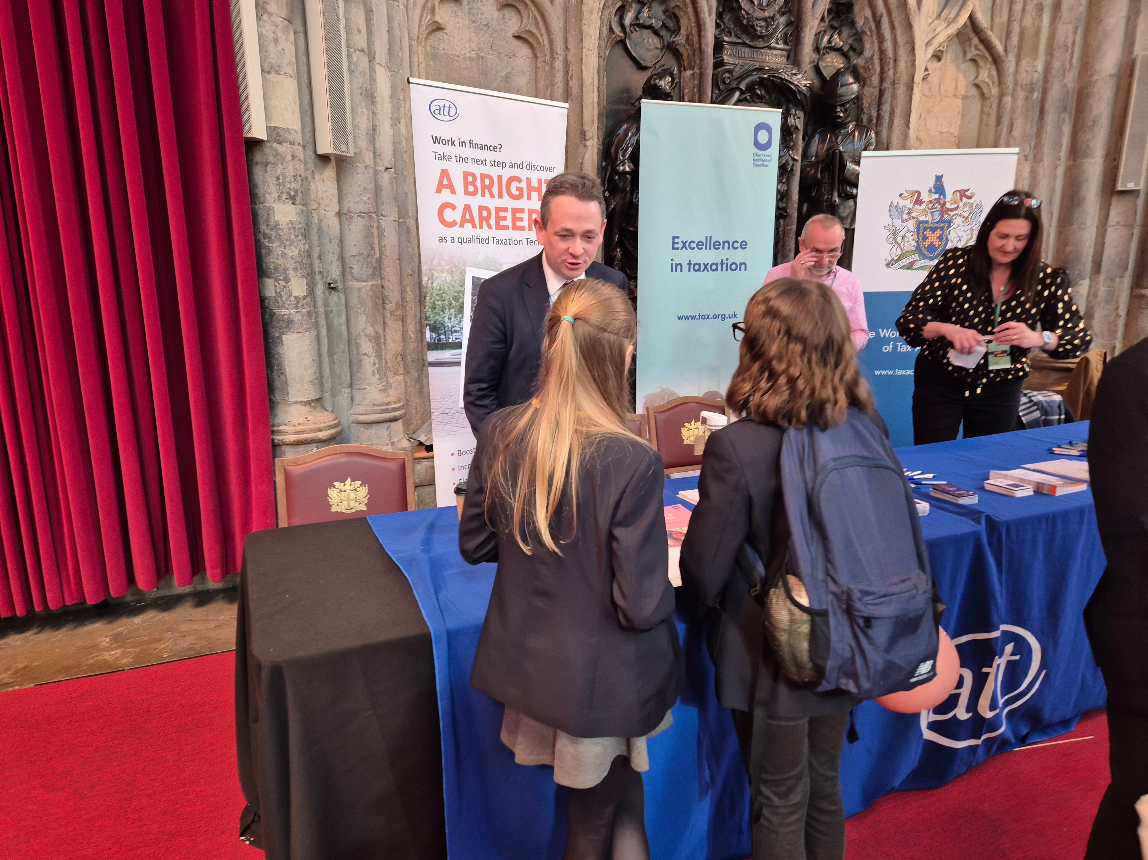
The Livery Schools Link (LSL) Cont.
The numbers (2026)
Stands
- Primary School Day – 23
- Senior School Day- 36
Th
Pupils
- Primary- 1369
- Senior - 1822
Outcome
- Reached 3,191 of Greater London school children at one event
- School talks
Achieving our objectives

Slide 9
The Livery Schools Link (LSL) Cont.
The costs (2026)
Stands
- Effectively Free of Charge, included as a benefit within WCTA’s paid membership of the LSL
Staffing
- Mainly volunteers from WCTA, the CIOT’s and the ATT’s young + CIOT employees, special thanks to Mel Dragu, Stephen Pinhey & Flossie Skinner
Outcome
- Low cost, high impact event, reaching a very diverse range of pupils
Achieving our objectives
Merchandise
- WCTA, commemorative playing cards, c. £1,000
- ATT & CIOT, pens, highlighters, z cards, tax facts c. £ 1,500

Slide 10
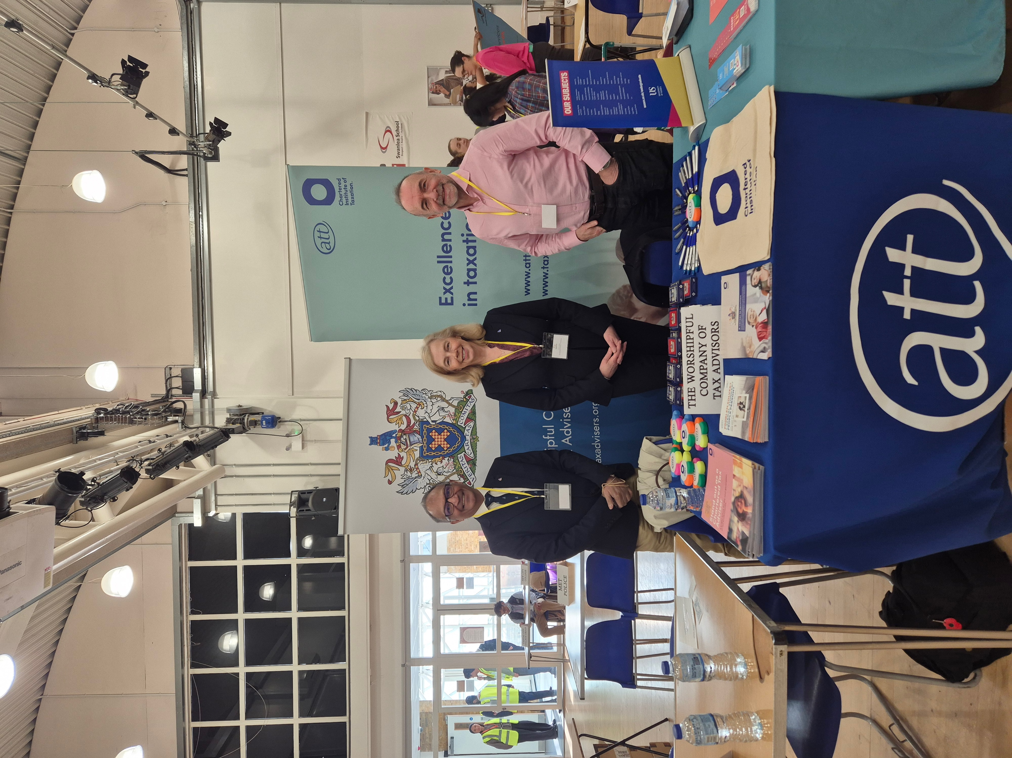
Swanlea School Careers’ Fair
Our team- collaborating
A further opportunity from WCTA’s membership of the Livery Schools Link
Non selective community school in Tower Hamlets’ district
Caters for 11 to 18 year old students
Over 1200 pupils
45.3% eligible for free meals
Ethnically diverse

Slide 11
Swanlea School Careers’ Fair
Our team- collaborating Cont.
"I enjoyed how I could talk to multiple different careers and find more about each career. This helped me be more aware of my career paths.”
“I learnt new things about a wide variety of companies. It was really useful information and the range of companies made it fun.”
“It was highly informative and there were such astute individuals.”
”It was helpful and nice to know about steps to take in the future”.
“There was a wide variety of career options to explore, and I had enough time to get my questions answered at each station”.

Slide 12
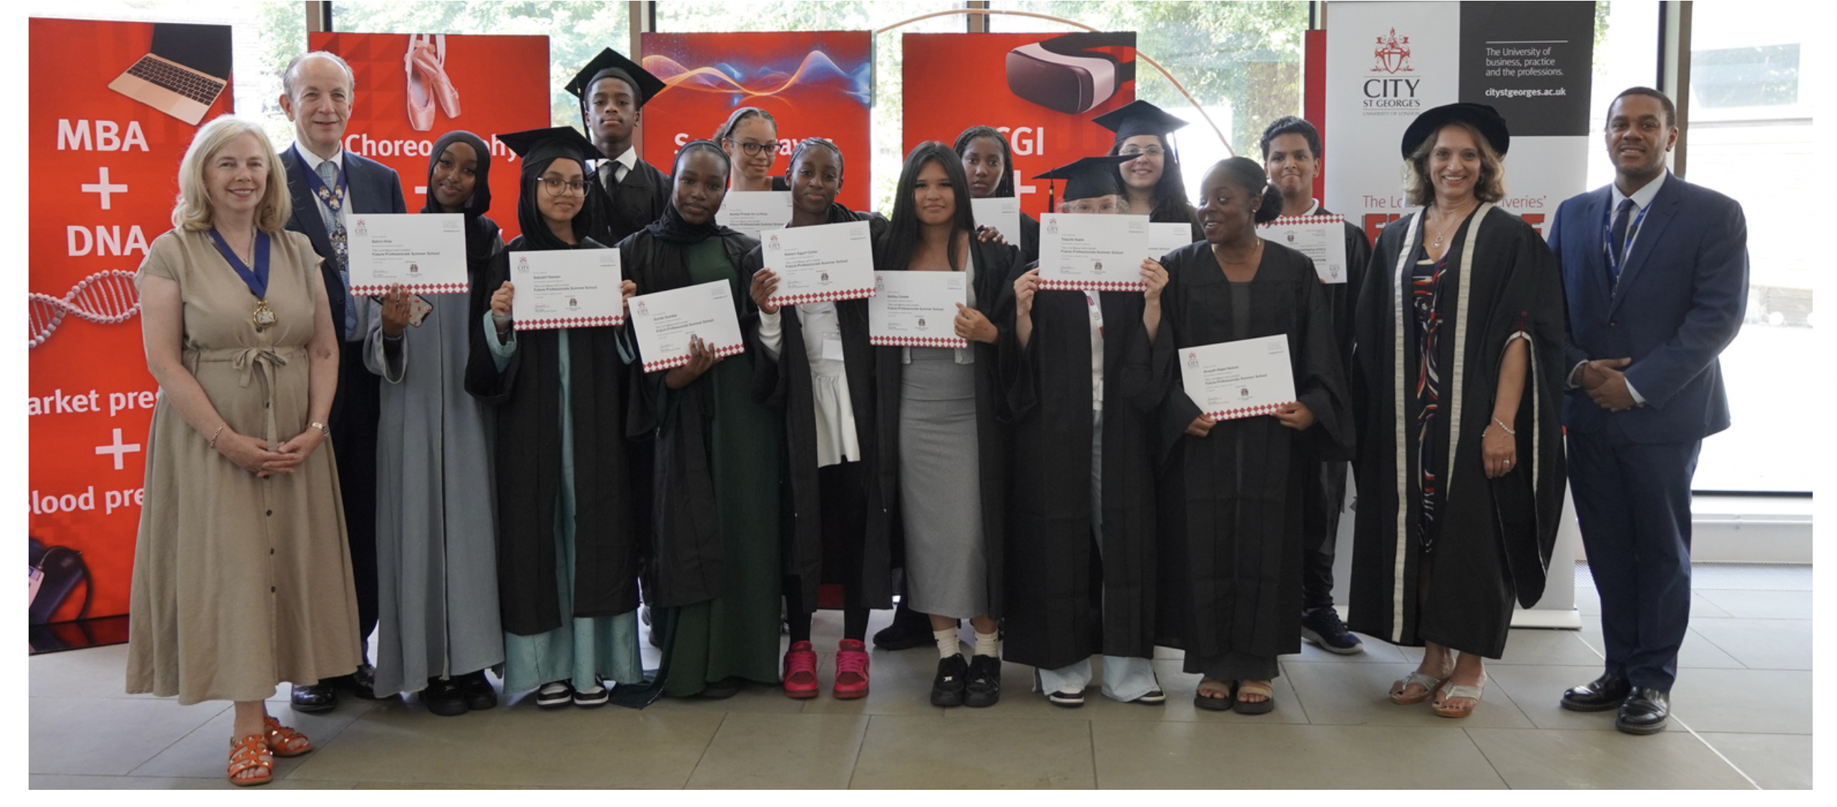
Further Complementary Activities by WCTA & its Charities
Local Village Network & The Livery Companies
Mentoring year 10 students on the Amplify Me Program
2025/2026 -Lilian Bayliss, Beacon High School, Haberdashers’ Hatcham College
Helping the students to prepare their CVs, to think about next steps after GCSEs, improve their networking skills, their impact and their public speaking skills .
Inspiring confidence and meeting our charitable pro bono aims
City St. George’s Future Professional Summer School
Sponsoring a number of places for students, especially from Mulberry UTC
Inspiring students to see that they can have a career in the professions and our profession in particular
Widening the impact of our charitable and educational support

Slide 13
Q&As

